Slide 1

Fundamentals of Energy Efficient Building Operations
Part 4: Energy Management

Slide 2
Agenda
Energy Fundamentals
Energy Accounting
Learning Activity: Interpreting Energy Bills
Energy Benchmarking
Calculating Costs and Savings of Efficiency Measures
Learning Activity: Utility Incentives Research

Slide 3

Building a Plan for Your Facilities
Determine baseline and set goals
Identify energy saving opportunities
Monitor energy consumption
Measure success
Notes:
Recall the steps for building a plan for your facilities that were discussed in Part 1. This section, Part 4, will help you understand how energy is used in your facilities and how to monitor energy consumption in your facilities. This is an important part in building an energy management plan for your facilities.

Slide 4


Where Do We Start?
Let’s Go Back To The Basics…
Energy Fundamentals
Notes:
Before we begin to discuss the actual energy consumption in buildings, it is necessary to discuss some energy fundamentals. This next section will describe basic energy concepts and fuel types commonly found in commercial buildings along with common units of measure.
Image Source: pexels.com

Slide 5
Energy Fundamentals
Common Building Fuel Types
Electricity
Lights
Motors (fans, process)
Air conditioning
Plug loads
Heating
Hot Water
Natural Gas
Heating
Hot water
Process
Back-up
Air Conditioning
Power
Fuel Oil
Heating
Hot water
Process
Back-up
Air Conditioning
Power
Liquefied Petroleum Gas (LPG)
Heating
Hot water
Natural gas/Oil back-up
Notes:
All buildings consume energy. The three most common types of energy consumed by buildings are electricity, natural gas, and fuel oil. In areas where natural gas is unavailable, it is common to see liquid propane gas (LPG) used. Electricity is by far the most common form of energy use, powering lights, fan and process motors, air conditioning, and plug loads such as computers, copiers, etc.
Natural gas is also found in most buildings and will typically supply the building’s heating (and possibly cooling), hot water, and process heating energy requirements. In some regions in the US where the price of oil and natural gas compete, natural gas could be a back-up to fuel oil.

Slide 6


Understanding Energy
Common Terms
Energy
Therms (natural gas), 1 Therm = 100,000 Btu
kWh (electricity), 1 kWh = 3,412 Btu
kBtu = 1,000 Btu
Power
Btu/hr or Btuh: 3,412 Btuh = 1kW
kW: 1kW = 3,412 Btuh
Ton (A/C), 1 ton = 12,000 Btu/hr = 3.517 kW
Btu = British thermal unit
The amount of heat energy needed to raise the temperature of one pound of water by 1°F.
A "ton of refrigeration“: The cooling power of one short ton (2,000 lbs.) of ice melting in a 24-hour period.
Notes:
Most often, you will find electricity measured in kilowatts (kW) and kilowatt hours (kWh). KW is the measure of power, or the rate at which electricity is used. KWh is the measure of energy, or the total amount of electricity consumed over time. Natural gas is typically measured in therms. In order to compare or total the amounts from all energy sources, you have to convert both to a common metric, Btu. Then you can compare how much energy you use in gas vs. electricity.

Slide 7
Understanding Energy
Consumption vs. Demand
Energy Demand
Energy need of a facility and how much the utility has to supply
Measured in kilowatts (kW)
Energy Consumption
Energy being consumed in a given time period
Electrical energy measured in kilowatt-hours (kWh)
Notes:
7
Your building or facility does not consume energy at the same rate all the time. Most facilities have a greater need for power during the day, with lights, air conditioning, several computers and process energy all operating simultaneously. At other times, perhaps weekends or early mornings, your facility may only be operating some lights and a couple of computers.
In both cases, energy, as measured in kilowatt-hours (kWh), is being consumed. During the period when more equipment is running, however, your facility has a higher rate of consumption, requiring a higher demand. Demand is measured in kilowatts (kW). Consumption of electricity (kWh) requires an electric company to provide and charge for the poles, wires, and transformers for a building. Demand (kW) determines the required size of the wires and transformers.

Slide 8

Understanding Energy
An Example:
Kilowatt = Power
Kilowatt Hour = Energy
100 lbs
100 lbs x 1 minute = 100 lb minutes
100 lbs x 2 minute = 200 lb minutes
200 lbs
200 lbs x 2 minute = 400 lb minutes
DEMAND CONSUMPTION
Notes:
8
Here is an example highlighting the difference between consumption and demand. Think of lifting weights. If you want to lift 100 pounds, you need power to lift that (that is the demand). Now if you want to hold it for one minute, it will require 100 pound-minutes of energy. If you want to hold it for two minutes, it will require you to consume 200 pound-minutes of energy. That is what your consumption is, in relation to a kilowatt hour.

Slide 9

Understanding Energy
Consumption vs. Demand – An Example
10 hp motor
10 hp motor at 75% load:
draws approximately 6 kW
consumes 60 kWh in 10 hours
100 hp motor at 75% load:
draws approximately 60 kW
consumes 60 kWh in 1 hour
The larger load requires:
higher demand
larger wires
larger transformer capacity
larger power plant
100 hp motor
Notes:
Let’s say there are two customers. One has a 10 horse power (hp) motor at 75 percent load and one has a 100 hp motor at 75 percent load. The rate of consumption, or demand, for the 100 hp motor is 10 times greater.
The larger load requires a higher demand from the utility. They will charge based on your highest load, which is called peak demand.

Slide 10
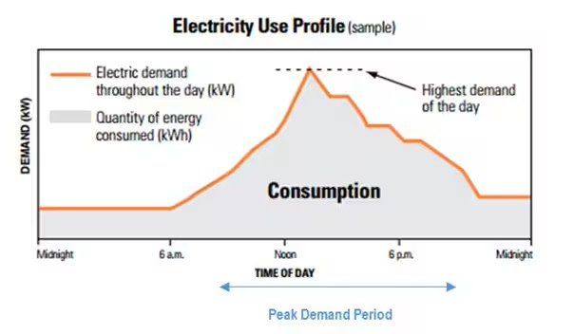
Demand Profile
Notes:
This graph shows an example of a demand profile. The line shows the different levels of electrical demand at different times throughout the day. The shaded portion beneath the line shows the total amount of energy consumed that day.

Slide 11
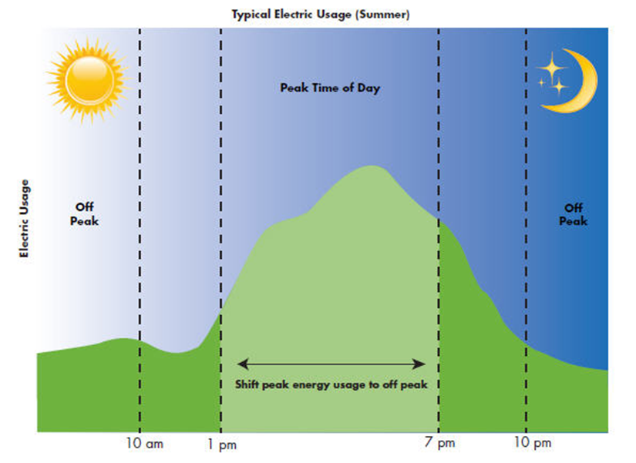
Peak Demand
Notes:
On an energy bill, peak demand is the highest power load measured during a segment of an hour in a billing period which represents the highest point of customer consumption of electricity. Reducing or shifting some loads to other times of day can help to spread them out throughout the day, helping to reducing demand charges.
Image source: https://www.dominionenergy.com/virginia/save-energy

Slide 12
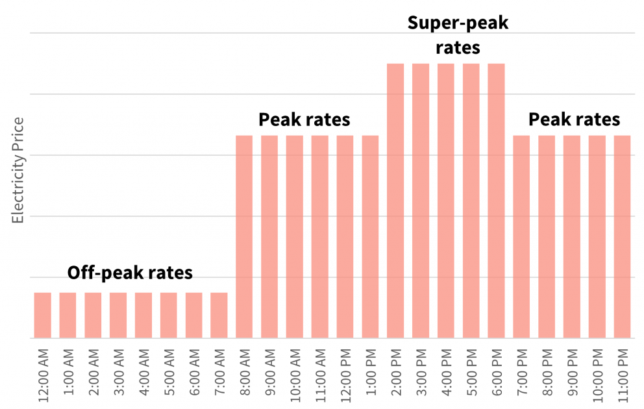
Utility Rates
Summer Utility Rates
During certain periods of a given day, the same unit of electricity can cost many times more!
Notes:
Peak demand on an energy grid is the time period when electricity consumption is at its highest. These periods of high use can put strain on the energy supply. Many utilities have implemented time-of-use rates to encourage customers to shift their loads and spread out the demand over the course of a day.
Image source: Con Edison

Slide 13

Demand Management Strategies
Utility Bill Monitoring
Load Shifting
Reviewing utility bills
Rescheduling load
Load Shedding
Reducing load
Demand Response Programs
Utilities and operators work together for a common goal
Notes:
13
There are several strategies to reduce your peak demand. Review each type and determine what might be best for your facility.
Utility Bill monitoring – Reviewing utility bills to monitor peak demand charges
Load Shedding - Reducing load (specific operations) to avoid peak demand hours
Load Shifting - Rescheduling load (specific operations) to avoid peak demand hours
Demand Response Programs - Incentive-based demand response programs pay participating customers to reduce their loads at times requested by the program sponsor, triggered either by a grid reliability problem or high electricity prices.

Slide 14
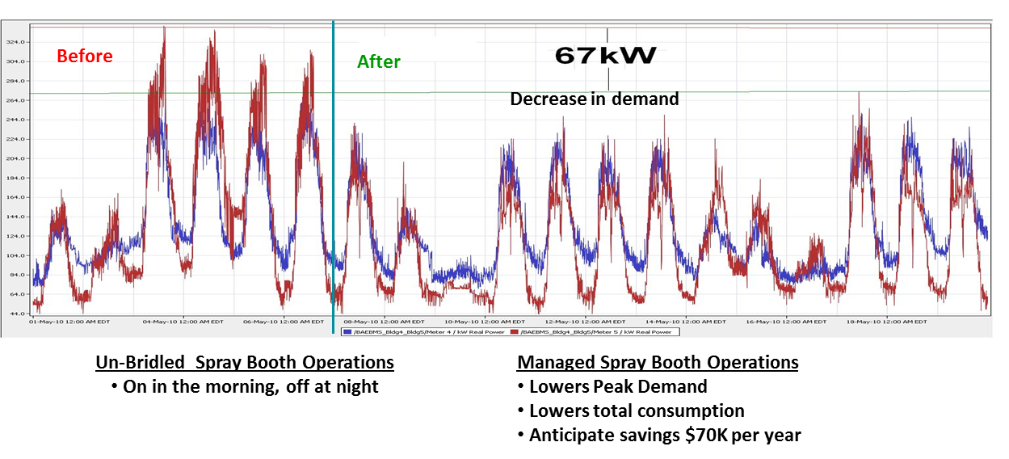
Case Study: Peak Demand Management
Notes:
BAE Systems, an aerospace manufacturer, conducted a study on the savings resulting from implementing a demand management program. After spray booth operations became a managed process, where the spray booth use was managed based on overall demand on the facility, they saw a decrease of 67 kW in daily demand, translating to a savings of $70,000 per year. As a result of these findings, BAE Systems implemented peak demand management enterprise-wide. The peak demand management program consists of several different components.

Slide 15
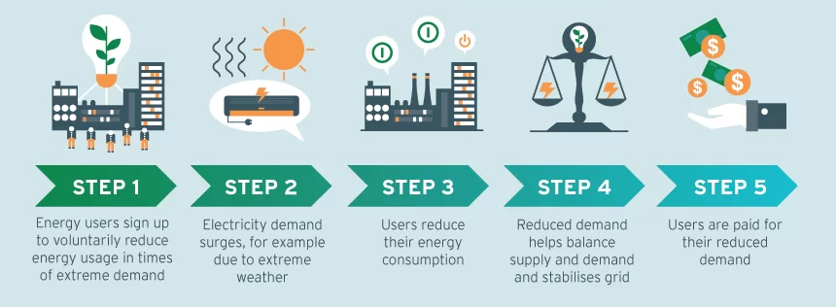
Demand Response Programs
Notes:
Sometimes energy supply on the grid can become overly constrained, such as during extreme weather events when customers use even more power than usual. To help solve this problem, many utilities have implemented demand response programs that offer financial incentives for reducing electrical loads during peak hours when the grid is overloaded, typically during summer months when air conditioning is frequently used. Many companies participate in demand response programs both for the financial incentive as well as to be socially and environmentally responsible.
Demand response is a tool that can also help utilities accommodate rising electrical demand on the grid due to factors like decarbonization initiatives and the increased popularity of electric vehicles, while avoiding costly upgrades. Avoiding costly utility projects like building new generating stations also helps to avoid those costs being passed on to the consumer.
Demand response can be accomplished manually, such as when building operators receive a signal from the utility and respond by manually turning off or ramping down nonessential loads. Or it can be accomplished automatically with specially installed equipment that recognizes a signal from the utility and automatically responds to decrease loads. Many utilities provide rebates and other incentives for implementing automatic demand response capability.
Image source: https://www.wtsenergy.com/glossary/demand-response-in-the-energy-industry/

Slide 16

Energy Consumption
Numbers Matter!
Notes:
To understand our energy consumption, we need to know our numbers! So, lets start with the basics.

Slide 17

Energy Accounting
Collect Utility Energy Data
Sources
Identify all energy sources
Electricity
Natural gas
Oil
Monthly Bills
Use most recent data
Minimum of 1 year, preferably 2 or 3
Usage data (kWh, therms, gallons)
Cost data ($)
Notes:
Evaluating energy performance requires good information on how, when, and where energy is being used. The first major step in energy accounting is to collect and organize all of the utility data for your facility or facilities. Make sure to identify and account for all of the energy that is used, including electricity, natural gas, oil etc.
Building energy consumption patterns change for a variety of reasons including weather, operations, or physical building alterations. Using the most recent data available is critical. If you do not have this data in your work area, very often it can be found in the accounting or purchasing department. It may also be held centrally at corporate offices. In many instances and often the easiest way to obtain the data is to contact the appropriate utility representative. They should be able to get what you need.
Make sure to gather a minimum of one year’s worth of data, but it is helpful if you can get two, three, or even more years of monthly usage history. Once you have the data, make an appropriate file for it and keep it where it is easily referenced.

Slide 18
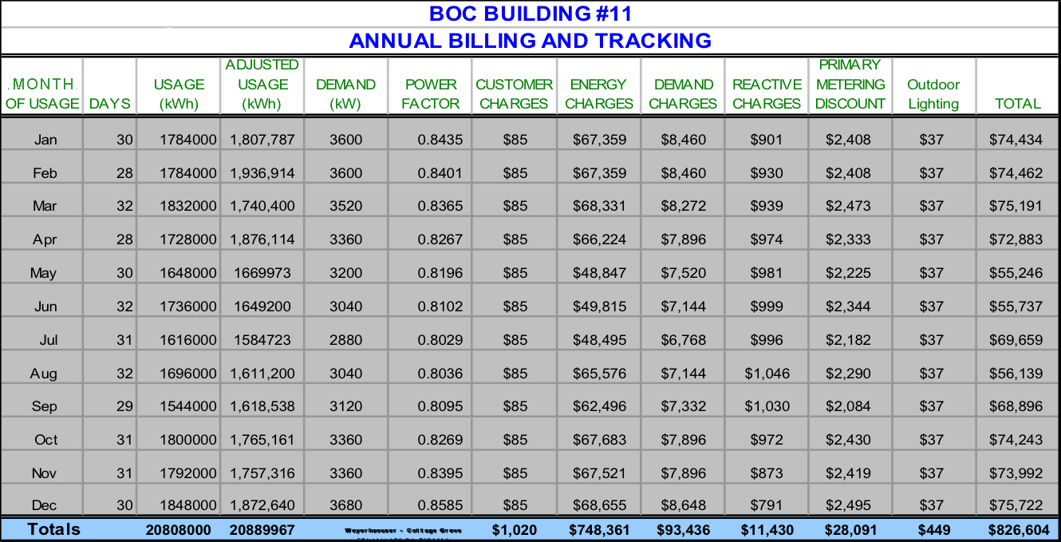
Energy Accounting
Organizing Utility & Building Data
Data Tracking Spreadsheet Sample

Slide 19

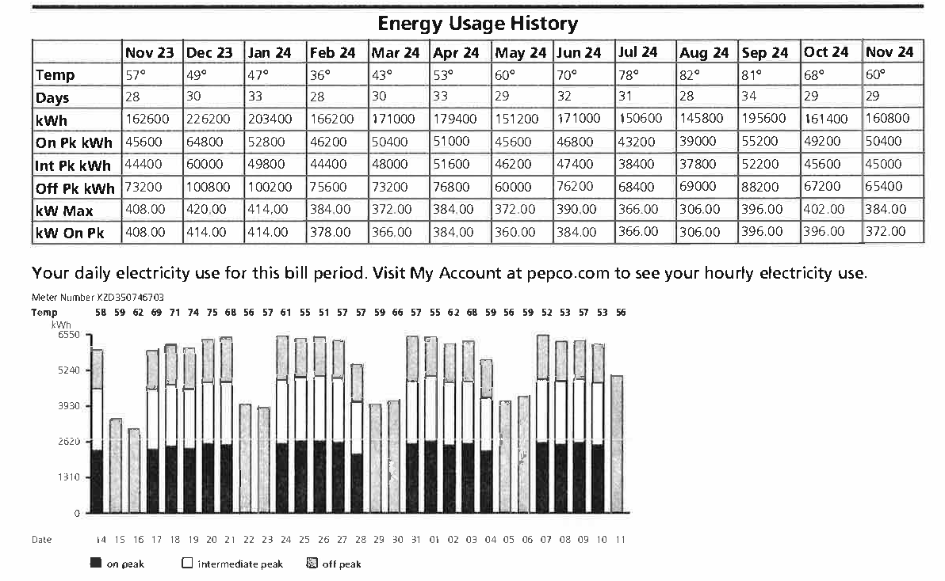
Electricity Bills
Notes:
Your electric bill typically will contain the following charges:
Delivery charges, the cost to bring electricity to the building
Energy charge, the amount of energy used (kWh) x rate ($/kWh)
Maximum demand, the highest rate of electricity used (kW) over a month x demand rate ($/kW)
Supply charges, the cost of producing the electricity
Other charges, including taxes and surcharges
The bill also provides a history of energy usage over the past year, as well as graphs of monthly and daily electricity use in kWh, and monthly electricity use in kW demand.

Slide 20
Utility Bills and Rate Structures
Typical Billing Components
Basic Service Charge, $/month
Fixed monthly fee
Covers meter reading, billing, and other administrative costs
Energy Charge or Rate, $/kWh
Total accumulated energy used per month, kWh
Constant or varied depending on rate schedule
Power and distribution
Power only for unbundled rates
Notes:
The basic charge, or customer service charge (CSC), is a fixed monthly fee that covers the costs required for the utility to read your meter, prepare the billing and other various administrative costs.
Energy charge is based on the total energy used in the month as measured in kWh. It is determined using the appropriate rate in $/kWh for the rate schedule applied to your facility multiplied by the total energy consumed during the month. Some utilities charge the same rate for all kWh you use during the month, while others may charge different rates for different “blocks” of energy.
The energy charge typically includes both the cost for the power, along with the maintenance required to maintain the poles, wires and transformers used to distribute the energy serving your facility.

Slide 21
Utility Bills and Rate Structures
Typical Billing Components
Demand Charge, $/kW
Rate of consumption, kW
Highest 15 minute or 30 minute average of month
Ratcheted or reset monthly
Distribution Charge, $/kWh
Unbundled rate component
Tied to total energy consumption $/kWh
Covers maintenance for poles, wires, transformers
Notes:
Consumption and demand were discussed earlier with the energy charge being the charge that accounts for the energy consumed in a building. Demand charges are applied to the rate (how fast or slow) at which a building consumes the energy. This is measured in kilowatts or kW. Most demand meters actually determine an average demand during a specified time period (usually 15 to 30 minutes) and ultimately record the highest value measured during the month.
The utility will charge for demand by either using this “peak” monthly value, or in some cases will use a “ratcheted peak” which is the highest value that has been measured during the current month or previous 12 or 36 month period. This ratcheted peak will then set the demand charge until a higher demand is measured. In either case the utility resets the demand on the meter each month.

Slide 22
Rate Structures
Seasonal
Rates vary throughout year
Typically separated by season (summer, winter, etc.)
Time-of-Use (TOU)
Rates vary during day
Peak and off-peak periods
Block
Rates vary by monthly consumption
Rates set in blocks of monthly usage (i.e. 0-500,000 kWh; 500,000 – 1,000,000 kWh)
Notes:
Up to now we have discussed many of the different components of electric bills, but not how they are combined to determine the final amount. How a utility combines the components is called the rate structure. Besides the basic rate structure which charges a fixed rate for all of the energy, a fixed rate for all of the demand, a fixed rate for power factor, etc., other common rate structures include seasonal rates, time-of-use rates, and block rates.
Seasonal rates account for the fact that a utility’s energy costs is going to vary by season depending on the demand, fuel costs, water levels etc. In this case it is not unlikely to see the rates a utility charges change 3 to 4 times throughout the year.
Time-of-Use (TOU) rates, on the other hand, are used to send the proper price signals to a facility owner regarding the cost of energy during specific times of day.
Block rates are structured by offering different rates as usage increases during the month and are often used to encourage a more efficient usage pattern.

Slide 23
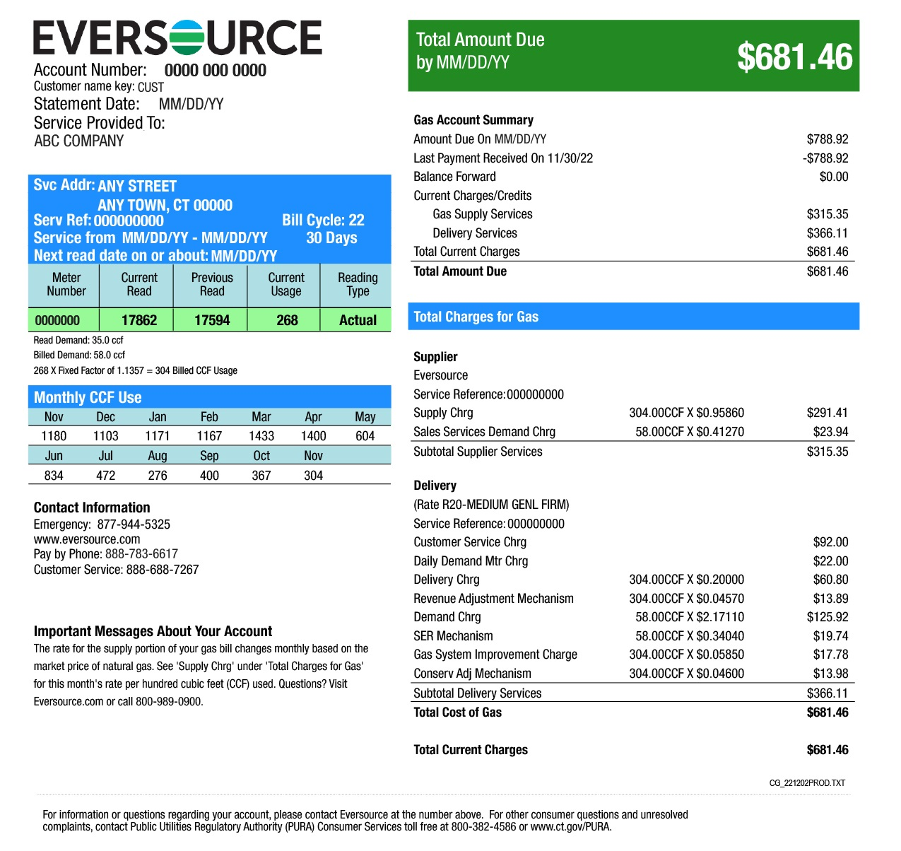
Gas Bills
Basic charges
Metered use
Demand
Delivery
Adjustments
Special Provisions
Image source: Eversource
Notes:
Like the concepts we discussed for electric bills, gas bills have a rate structure and billing components that are listed on the utility’s web site and are approved by the state utility commission. When assessing a building for opportunities to reduce energy use, it’s important to consider all energy sources, including electricity and gas. Water use, waste, and greenhouse gas emissions can also be benchmarked and reduced.
Image source: Eversource

Slide 24

Learning Activity #4A
Interpreting Energy Bills
Turn to the Appendix of your handbook

Slide 25

Energy Benchmarking
You can’t manage what you don’t measure.
The foundation of sound and sustainable energy management
Monitor Btu (more control) vs. Monitor $ (less control)
Notes:
Understanding how energy is being supplied to the facility and how it is billed is a first and necessary step to managing the energy serving a facility. A familiar phrase that applies directly to improving the energy performance of a facility is:
“You can’t manage what you don’t measure.”

Slide 26
Benchmarking
A continuous, systematic process for evaluating energy performance of a building
Identifies how a building performs relative to previous performance, portfolio, national average, standard
05
04
03
02
01
Benchmarking isn’t the destination – more of a mile marker.
Notes:
A benchmark is a standard by which something can be measured or judged. And it helps you evaluate your performance. Collecting data and comparing it to a standard provides deeper insight into performance versus just knowing energy use.

Slide 27

Benchmarking allows you to:
73
88
21
Compare your building to a national sample of similar buildings
Compare your buildings of a similar type to each other
Identify underperformers in your portfolio and set priorities for the use of limited staff time and/or investment capital
ANY building can be benchmarked.
Notes:
Benchmarking energy consumption allows you to:
Evaluate portfolio-wide performance
Understand individual building performance
Compare energy performance to national median
Identify and address potential problems by looking at monthly trends
Track the impact of energy, water, waste management strategies

Slide 28
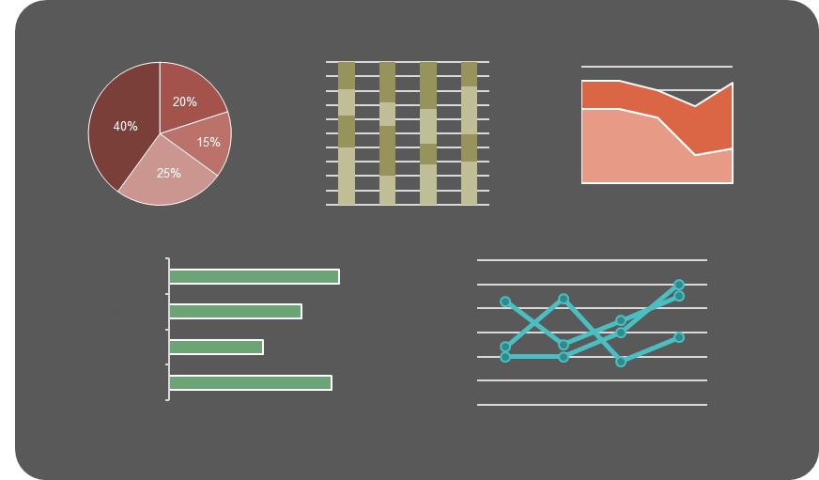
Common Benchmark Metrics
Energy Metrics:
Energy consumption per square foot
Energy consumption per person
Percent of renewable energy

Slide 29
Energy Metrics
Energy Use Intensity/Energy Utilization Index (EUI) - measure of the total energy consumption over the course of a year
=
Energy Consumption (kBtu)
Building Square Footage
The Lower The EUI, The More Efficient Your Building Is
Notes:
The terms “Energy Use Intensity” and “Energy Utilization Index” (EUI) are used interchangeably as a measure of a building’s energy efficiency. A key number to know is your EUI. It is calculated by dividing the building’s energy consumption in kBtu by its square footage, which allows for comparison of buildings of different sizes. Knowing your EUI helps you set a baseline. A baseline is essential to measuring improvement, as it outlines a starting point and allows you to monitor progress over time.
The lower the EUI, the better the energy performance tends to be.

Slide 30
Energy Utilization Index
Pros:
Industry standard approach
Simple to calculate
Easy to compare buildings year-to-year
Cons:
Not weather-normalized
Does not account for building use factors

Slide 31
Energy Utilization Index
ddddd
100,000 SF Office Building
Pittsburgh, Pennsylvania
EUI = 83
How do you know if your EUI is good or bad?
Notes:
Let’s say we have a 100,000 sf office building in Pittsburgh. We calculate the EUI to be 83. How do we know if that is good or bad? This is where benchmarking comes in.

Slide 32
Benchmarking
Energy Use Intensity (EUI)
Category | Primary Function | *Site EUI kBtu/ft²
Office | Office | 52.9
Office | Medical Office | 97.7
Education | K-12 | 48.5
Education | College/University | 84.3
Public Services | Courthouse | 101.2
Public Services | Fire Station | 63.5
*National Median Site EUI
Source: ENERGY STAR Technical Reference U.S. Energy Use Intensity by Property Type, August 2024
Notes:
Once you have calculated your building’s EUI, you can use it to benchmark your building. In order to benchmark it is very important to compare apples with apples. You should benchmark your building with other similar buildings. If your data is not weather normalized, it will do you no good to benchmark a building in California against data based on a building in Colorado.

Slide 33
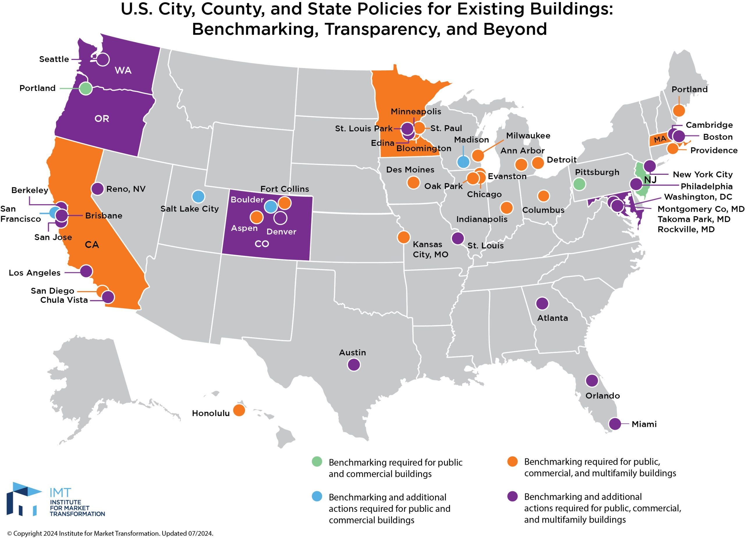
States and Cities with Benchmarking Policies
Vermont
Pittsburgh
Philadelphia
Michigan
New York
Mass
DC
Pennsylvania
Illinois
Indiana
Ohio
West Virginia
Kansas
Missouri
Roswell
Virginia
Kentucky
Atlanta
North Carolina
Oklahoma
Tennessee
Arkansas
South Carolina
Mississippi
Alabama
Georgia
Texas
Louisiana
Notes:
A benchmark is a standard by which something can be measured or judged. Benchmarking allows you to compare the energy performance of your building over time (e.g. year to year) or against similar facilities or an established level of performance. Benchmarking can also be performed for water use, waste, or greenhouse gas (GHG) emissions.
You may recall this map from Part 1. The highlighted states and cities are those that have some type of energy benchmarking requirement. Visit the website for the Institute for Market Tranformation (IMT) for more details on individual requirements.
Link: https://imt.org/resources/comparison-of-commercial-building-benchmarking-policies/
Image source: https://imt.org/resources/map-u-s-building-benchmarking-policies/

Slide 34
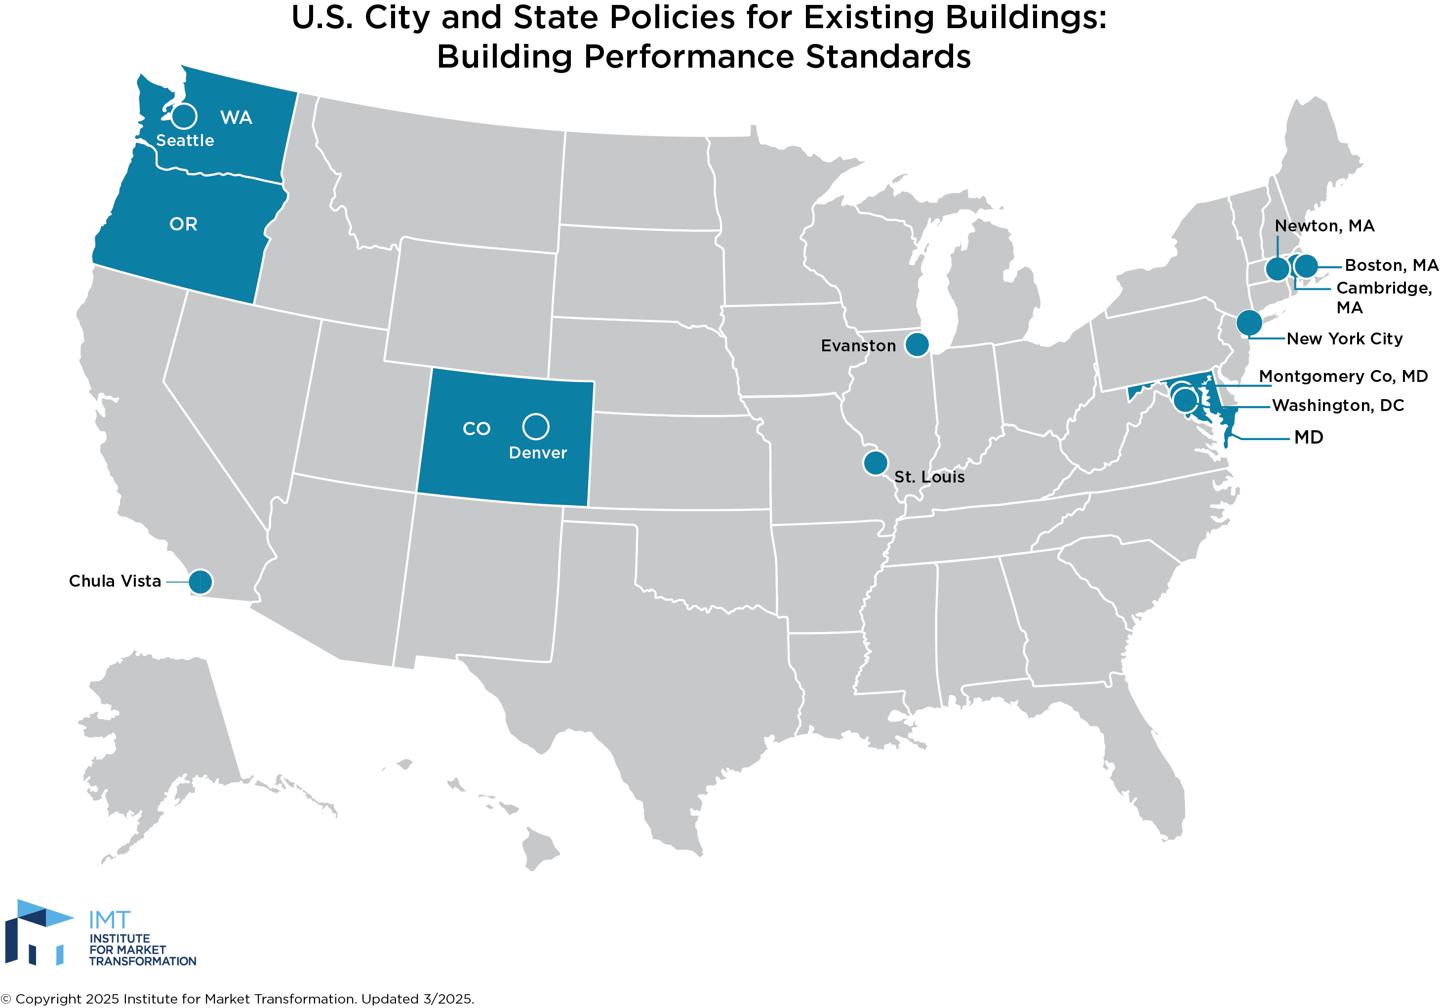
Building Performance Standards
Notes:
States and cities have also been moving ahead beyond benchmarking requirements with building performance standards to reduce energy consumption and greenhouse gas emissions. The map above shows the states that have enacted building performance standards as of 2025. In addition to building performance standards, decarbonization initiatives are also being enacted.
For example, California has enacted several decarbonization initiatives including:
SB-100 (Carbon Neutral Electricity by 2045)
B-55-18 (Executive order for economy-wide neutrality by 2045)
SB-32 (CA Global Warming Solutions Act 2016, with a goal of reducing GHG emissions to 40% below 1990 levels by 2030)
Washington State has enacted the Clean Buildings Performance Standard, requiring commercial buildings to meet use-specific EUI targets.
Many cities have adopted related initiatives as well, for example in New York City, Local Law 97 establishes a carbon cap on existing buildings, which has helped to accelerate the discussion of colder-climate electrification. And the Berkeley, California Existing Buildings Electrification Strategy adopted in 2021 focuses on beneficial electrification retrofits for existing buildings, with a timeline to transition completely off fossil fuels in buildings by 2045. Several cities have enacted laws banning new gas hookups in new construction.
Image source: https://imt.org/resources/map-building-performance-standards/

Slide 35
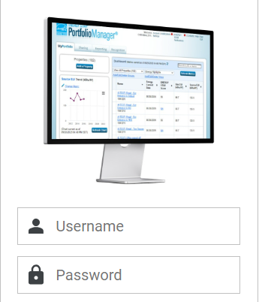

Benchmarking in ENERGY STAR® Portfolio Manager®
Notes:
ENERGY STAR® Portfolio Manager® is a free, interactive energy management tool that allows owners and facility managers to track and assess energy and water consumption across an entire portfolio of buildings. The tool can be used to determine Energy Star rating (0-100). Buildings are compared against similar buildings, nationwide, using Commercial Building Energy Consumption Survey (CBECS) data. Comparing the past performance of a building to current energy performance can provide further insight and might lead to additional energy savings.
Note: In contrast to an EUI, the higher the Energy Star rating, the better the energy performance.
Questions to ask include:
Has the EUI increased over time? Has the Energy Star rating decreased?
Can the change be correlated to a change in hours of occupancy, a decrease in vacant space, equipment additions or equipment changes? If not, it probably indicates an opportunity to reduce energy use.

Slide 36

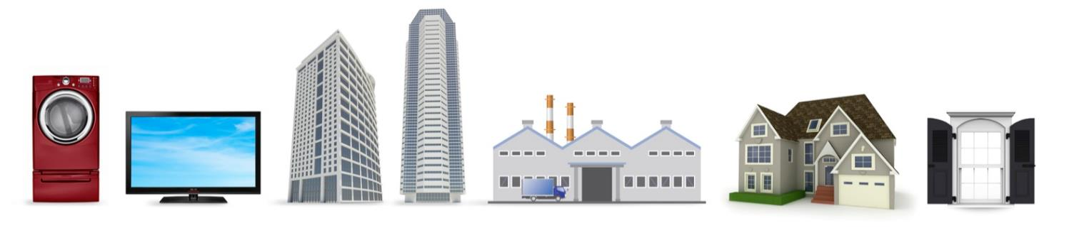
The biggest little label in energy efficiency
ENERGY STAR®
5.5 billion
products
30,000
buildings
130
industrial plants
1.7 million
homes
Notes:
Since 1992, EPA’s ENERGY STAR® program has identified the most energy-efficient products, buildings, plants, and new homes – all based on the latest government-backed standards.
Today, every ENERGY STAR® label is verified by a rigorous certification process.

Slide 37

ENERGY STAR® Portfolio Manager®
What is it for?
Standardized metric of energy performance
Compare efficiency across country (scale of 1-100)
Normalize energy consumption
What can it do?
Track building/facility performance
Assist with achieving LEED certification
Who can use it?
All buildings can use the tool
Certain types can benchmark similar buildings
Certain criteria must be met for rating
https://portfoliomanager.energystar.gov/pm/home.html
Notes:
There are tools which can also help you get an understanding of your building’s energy performance. One of these is ENERGY STAR® Buildings Portfolio Manager, which is based on energy use and lets you compare the energy performance of your facilities to similar buildings nationwide. Portfolio Manager also normalizes for weather and several other important building and operational characteristics, allowing comparisons to be made on a level playing field. Once you have achieved the required performance your building can then be recognized and obtain an ENERGY STAR ® label.
Get started at https://portfoliomanager.energystar.gov/pm/home.html
Other rating systems include:
LEED – based on points (1-110)
IGCC/ASHRAE 189.1 code

Slide 38
Discussion Question
My Building’s Energy Star Score is:
50 - 74
75 - 85
90+
I don’t know

Slide 39
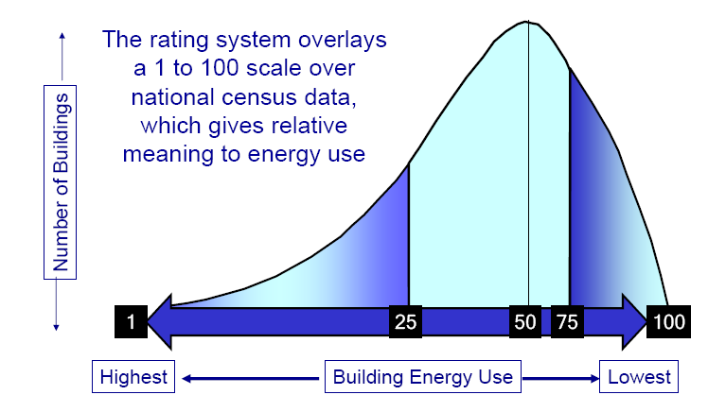
How to Improve
1–49 New equipment & best practices
50–74 Best practices & equipment upgrades
75–100 Congratulations! Build on your success

Slide 40
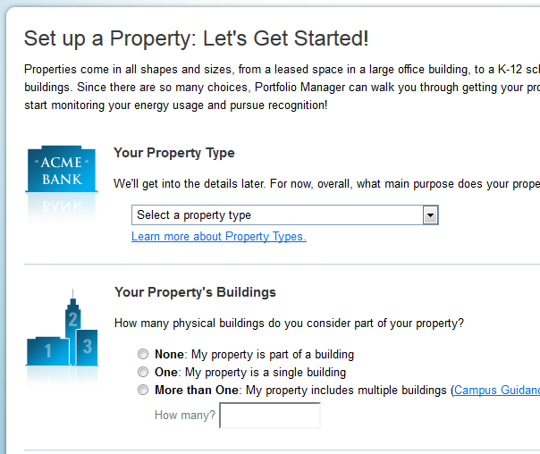
Portfolio Manager® : Adding a Property
Property name
Address
Property type
Year built
Gross floor area
Irrigated area
Occupancy
Operating hours
Number of workers
Number of computers
Percent heated/cooled
Energy data
https://portfoliomanager.energystar.gov/pm/dataCollectionWorksheet
Notes:
To add your property, start by completing the Data Collection Worksheet found at this link:
https://portfoliomanager.energystar.gov/pm/dataCollectionWorksheet
You will need to gather the information listed above about the building, as well as any other info requested appropriate to your building type.
Then, click the “Add a Property” button near the top left on the ESPM main page, and follow the instructions to set up your property.

Slide 41
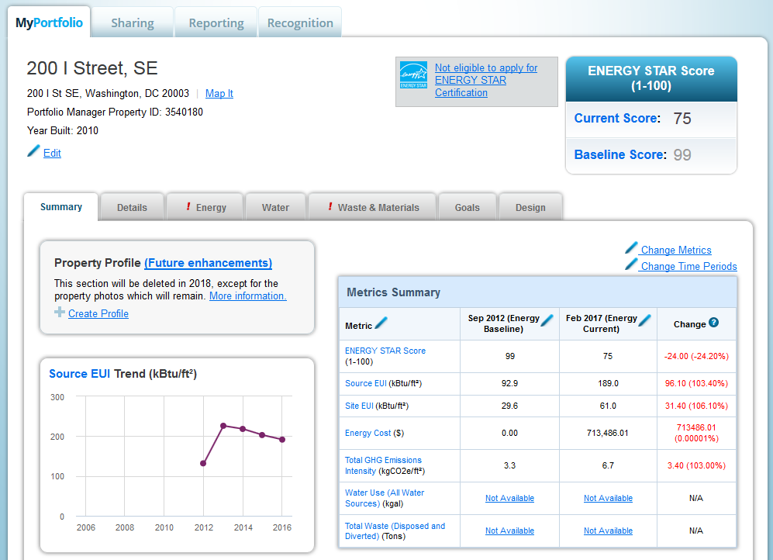
Portfolio Manager® : Property View
Notes:
Once you finish adding your property, you can view, maintain, and monitor it from the property page. The property page is accessed from the main page by clicking on the property name.
In the Summary tab, the Metrics Summary table shows the current data vs. the baseline and the difference between them (green is good, red is bad).
You can also monitor trends in EUI and GHG emissions over the years in the graphs at left.

Slide 42
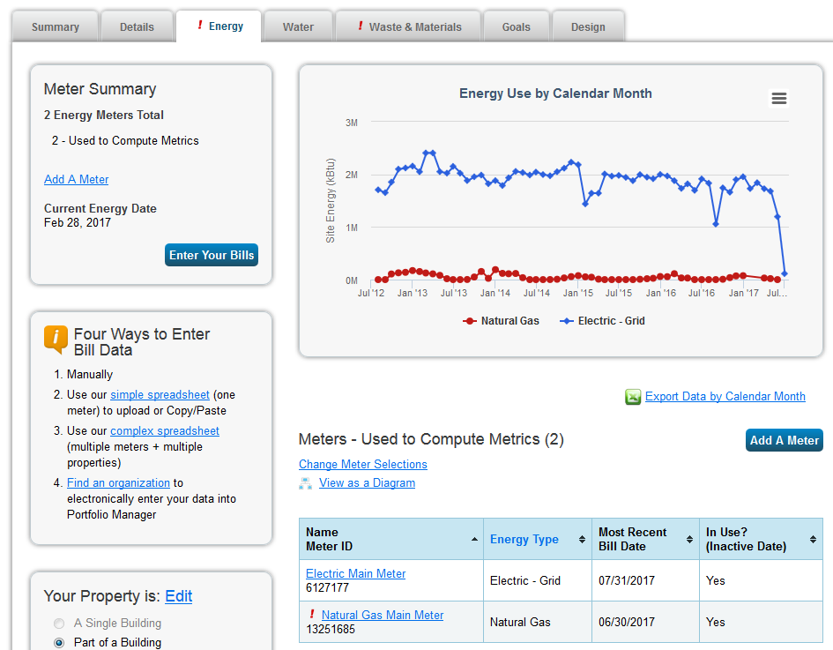
Portfolio Manager® : Energy
Notes:
In the Energy tab, the graph shows energy use by month for each energy source. You can also download this data to an Excel spreadsheet.
The energy data comes from the utility company. Many utilities allow for automatic updates of your energy data to your ENERGY STAR Portfolio Manager account. It is worth setting up this feature if you can. Otherwise, you will have to manually enter the data from the bills you receive.

Slide 43
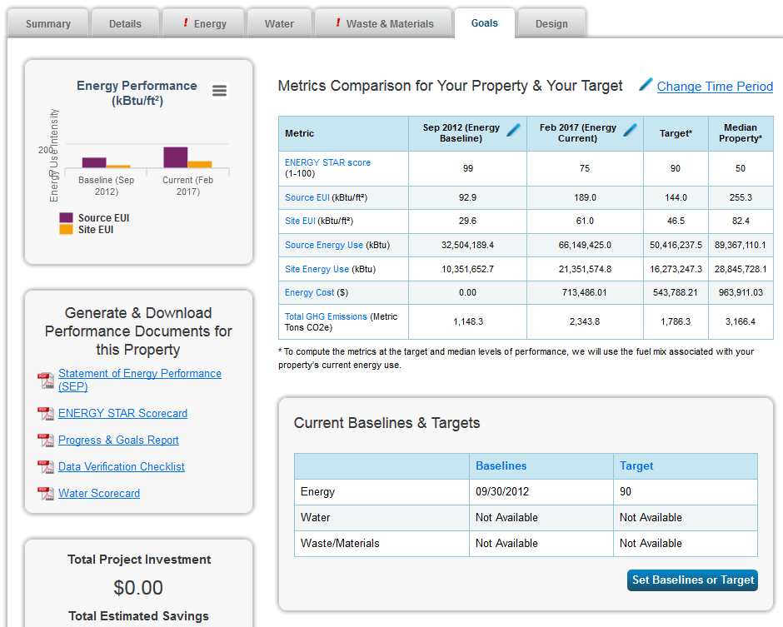
Portfolio Manager ® : Goals
Notes:
The Metrics Comparison table in the Goals tab shows more detailed data than the one in the Summary tab, which you can compare to your targets as well as the median property to see if you are on track with your goals.
You can set baselines and targets in the box below the table.
A useful feature found to the lower left of the table is the ability to quickly generate performance documents that summarize the data neatly in a report.
More customized, in-depth reports can be created in the Reporting tab near the top of the page.

Slide 44

Quick Tips and Facts
Buildings are compared with CBECS, not with other buildings in Portfolio Manager
Enter as few spaces within the building as possible
Enter as few space types as possible
You must include all energy use
Source energy factors are national
Emissions factors are regional
Operating Hours - when people are in
the building (not when equipment turns on)
Workers
Workers on a single shift
Not visitors
Notes:
The tips above will help make sure you enter your data accurately and completely and that you understand how it is being used in ENERGY STAR ® Portfolio Manager®.
Note: Portfolio Manager® uses data from the Commercial Buildings Energy Consumption Survey (CBECS) to compare buildings’ energy performance, not other data from other buildings entered in Portfolio Manager ®.

Slide 45
Common Errors and Red Flags
Incomplete Meter Data: All meters must have complete usage data through the end of the reported period
Gaps and Overlaps in Meter Data: Gaps or overlaps in the meter data of more than one day will cause errors in Portfolio Manager
Meters not associated: All building-level meters must be associated to a building so they are counted toward its performance metrics
Length of meter entries: No individual electrical meter entry can be for a period longer than 65 days
Common Causes of Extreme Energy Use Intensity (EUI) or Water Use Intensity (WUI) values, or Extreme Fluctuations:
Mismatched units – confirm that the units listed in Portfolio Manager® match the units on your bill.
Missing digits
Extra digits or transposed digits
Swapped cost and consumption information
Notes:
Incomplete Meter Data:
For example, if you run a report for the period ending December of 2024, then all meters in each facility in the report must have complete data from 1/1/2024 through 12/31/2024. If you believe that the facility data is up to date and complete, click on the facility name in Portfolio Manager and scroll down to the Energy and Water Meters sections. Examine the displayed information for all meters, especially the Last Meter Entry (End Date) and Alerts columns.
Fluctuations: Pay attention to the meter data for all facilities with extremely high or extremely low Energy Use Intensity (EUI) and/or Water Use Intensity (WUI) values, or an ENERGY STAR score of 1 or 100.
If you are unsure of the units listed on your bill, contact your utility provider.

Slide 46
Discussion Question
True or false: A low EUI is better than a high EUI.
True
False

Slide 47
Site EUI of Newly Modernized DC Schools
Notes:
Portfolio Manager gives you comparative metrics that let you contrast the energy use of buildings in your portfolio.
What does this accomplish? It gives you data that you can turn into questions: Why is McKinley Tech’s EUI so high? You then turn those questions into actions: I’m going to operate the lighting and HVAC at McKinley on a similar schedule to River Terrace. What is River Terrace doing differently? I’m going to talk to the facilities personnel at River Terrace. Those questions can become improvements and those improvements can turn into savings.
Benchmarking information enables you to:
Uncover inefficiencies you didn’t even know about
Know where to prioritize spending
Verify whether changes made are having an impact
This is the power of information, and this is the value of benchmarking.

Slide 48
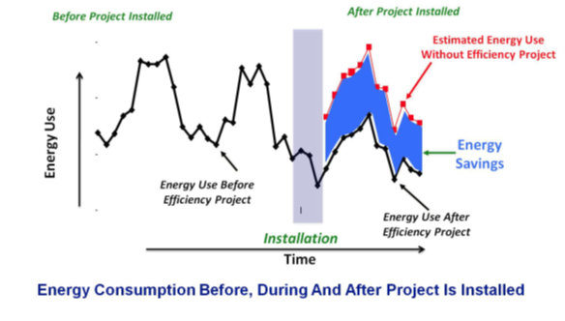
Calculating Savings from Efficiency Measures
Before Project Installed
After Project Installed
Notes:
Once you have a baseline of your energy use, you can benchmark against it as you implement measures to reduce energy consumption, so that you can quantify the outcome of your efforts. Understanding how to calculate estimated costs and savings related to efficiency measures can help you to identify and prioritize projects that will yield the greatest outcome, and to verify savings once projects are implemented.
Image source: https://srsworx.com/2021/01/05/devil-is-in-the-details-measuring-energy-savings/

Slide 49
Calculating Simple Payback & Return on Investment
Simple payback (SPB) in years
$ Cost of retrofit or measure
SPB =
Annual $ savings
Return on Investment (ROI) (%)
Annual $ savings
ROI = x 100
$ Cost of retrofit or measure
Notes:
Simple Payback is a simplified method to estimate overall savings for a project. While it does not include the time value of money, it does give an idea of the approximate time that it takes to pay back the cost of a project.
Return on Investment is another economic performance measure used to evaluate the efficiency of an investment. It also does not include the time value of money.

Slide 50
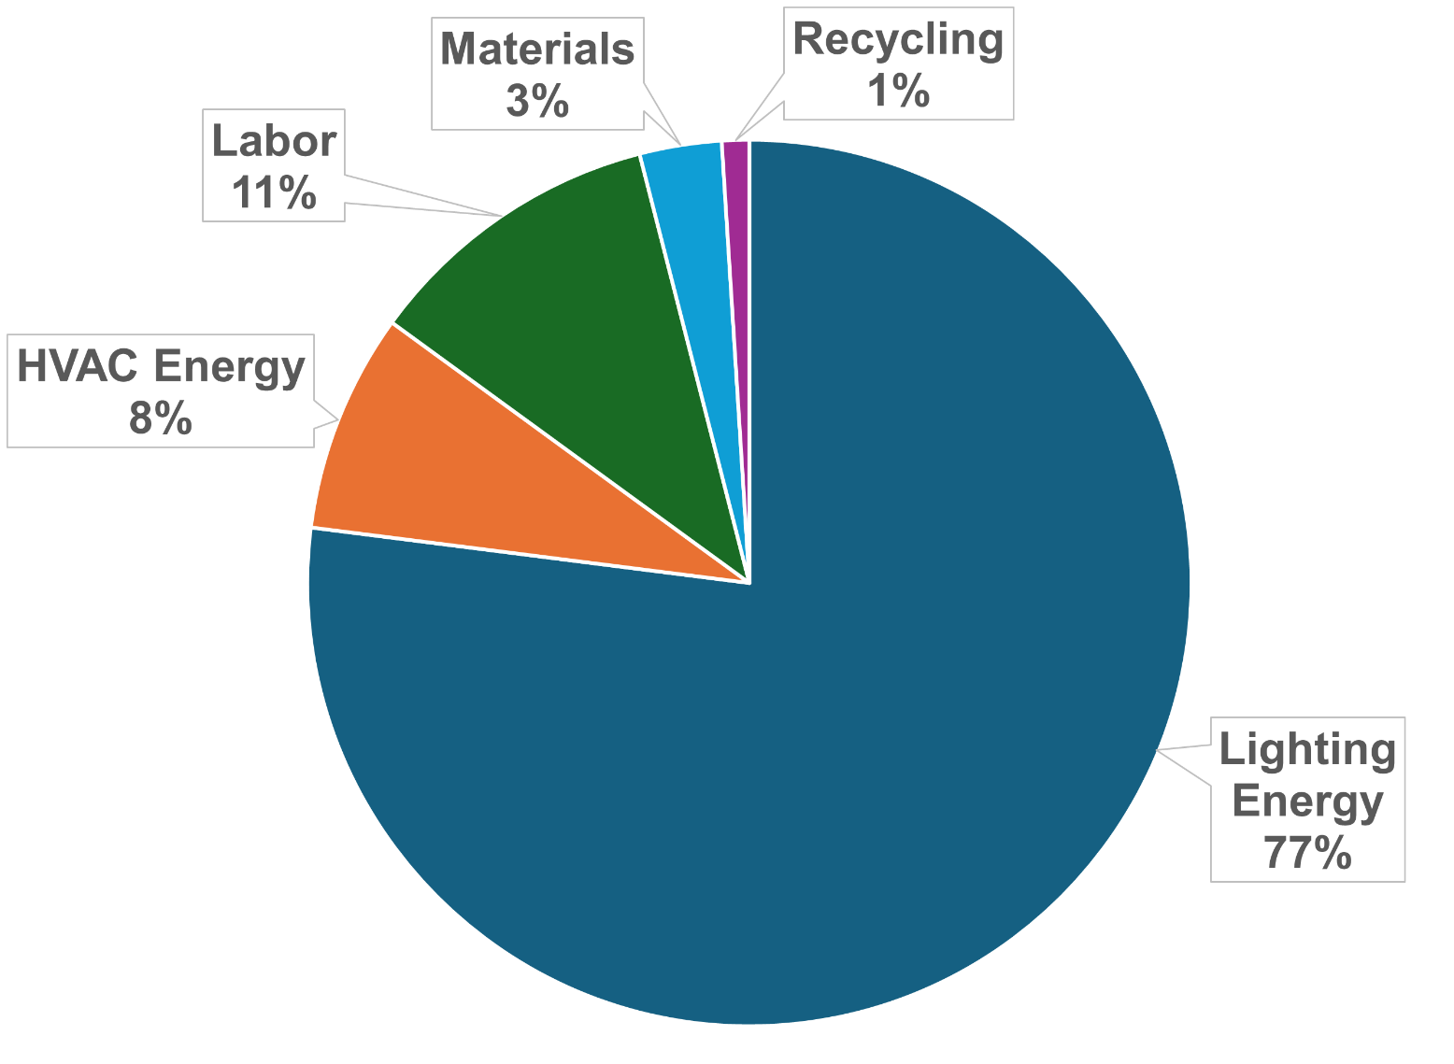
SBP and ROI Example: Total Ownership Costs
Total Ownership Costs Over Life of Typical Lighting System
Notes:
To illustrate the process of calculating simple payback (SPB) and return on investment (ROI) for efficiency upgrades, let’s look at lighting.
As you can see from the pie graph of the total ownership costs over the life of a traditional lighting system, energy related to operating lights is much greater than the cost of materials or installation labor costs. This includes electricity used directly for lighting, as well as indirectly to offset heat produced by lighting.
When assessing an upgrade, consider the total costs. Often, the higher purchase price for more efficient equipment can quickly be recovered through lower electricity costs.
Source: https://www.regencysupply.com/resources/total-cost-of-lighting/

Slide 51

Calculating Project Costs
Estimate cost of retrofit project
Include all costs (material, labor, recycling, rental equipment like lifts, etc.)
Utility Rebates
Utility incentives may include a rebate per number of units replaced or a $/kwh savings estimate
Estimate annual cost savings
Energy reduction
Maintenance
Notes:
We are using lighting as an example here, but these concepts apply to any retrofit project or other efficiency measure.
Make sure that all costs are identified when calculating the cost of the project.
We only estimated the savings on the previous calculation.
Many electric utilities have incentive programs to encourage their customers to install high-efficiency energy-using equipment. For lighting, this is often in the form of a rebate amount per lamp or fixture. Larger projects may be eligible for a grant based on the annual electrical savings. Contact your local utility representative to determine if rebates are available for your building.

Slide 52
SPB and ROI Example
Project: Installing 1 dual-technology wall-box vacancy sensor Project Cost
Cost of wall-box sensor $ 100.00
Cost of installation labor (0.75 hr. @ $100/hr.) = $ 75.00
Less utility rebate $.25/kWh x 576 kWh saved= ($144.00)
Total cost = $ 31.00
Savings estimated at 25% of annual hrs-of-use
3,000 hrs. x 25%= 750 hrs.
kWh savings = 0.768 kW x 750 hrs. = 576 kWh
Savings/yr. at $0.10/ kWh= $ 57.60
SPB = $31.00 / $57.60 = .54 yrs.
ROI = $57.60 / $31.00 x 100 = 186%
Notes:
This is an example calculation of savings from installing a vacancy sensor in a meeting room. Assume the fixtures before the sensor was installed drew 768 watts total, or .768 kW, and that the vacancy sensor yields a 25% reduction in lighting hours. The local utility charges $.10/kWh, but offers an incentive of $.25/kWh saved. As you can see, the project pays for itself in about 6 months with the savings in electricity costs (SPB) and yields an ROI of 186%.

Slide 53
Learning Activity #4B
Utility Incentives Research
Turn to the Appendix of your handbook

Slide 54




End of Module I
What Did We Learn?

